Slide 1


Slide 2
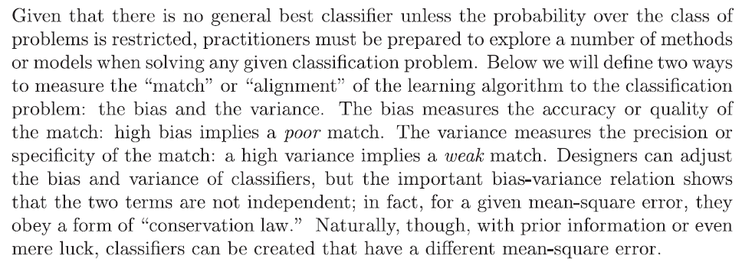

Slide 3

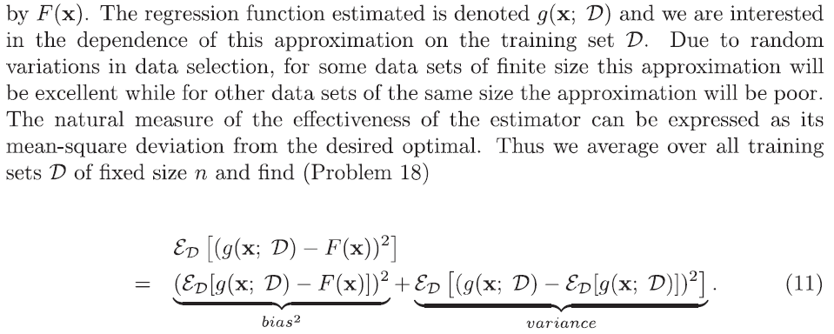

Slide 4



Slide 5



Slide 6


Slide 7

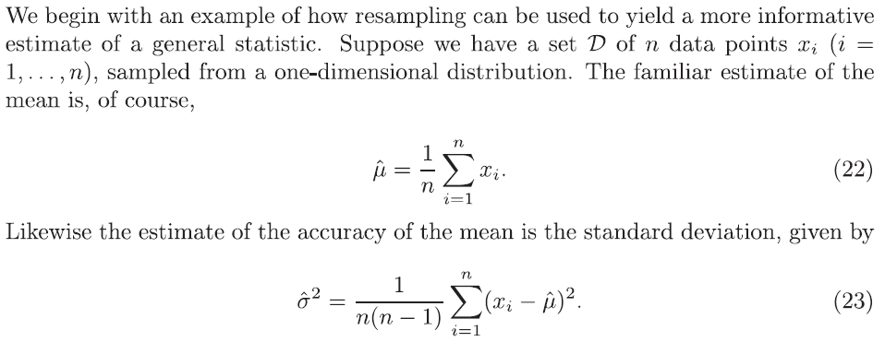

Slide 8


Slide 9
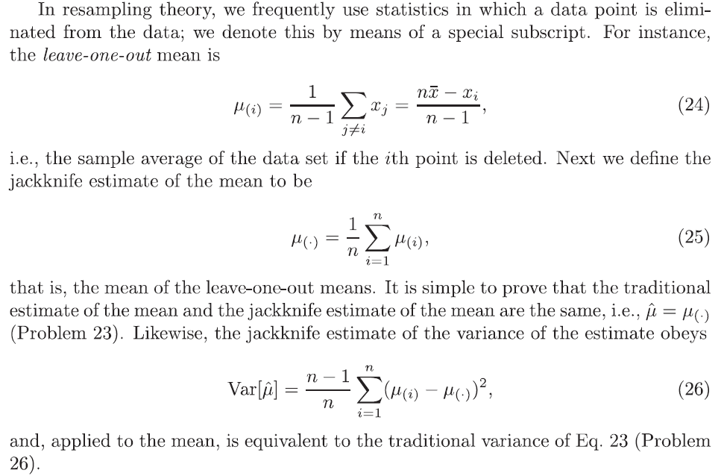

Slide 10


Slide 11

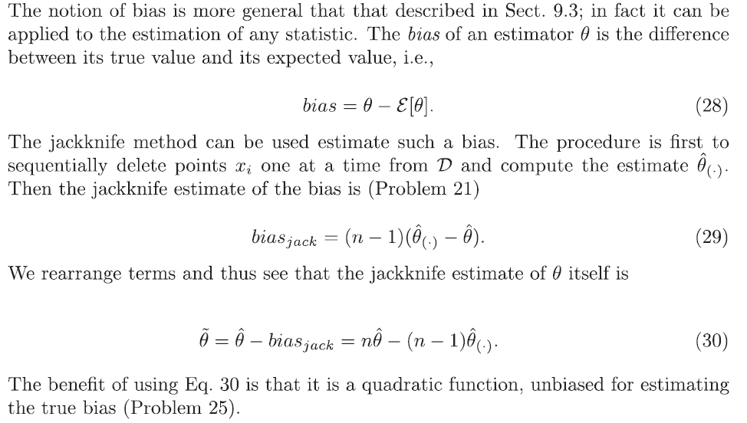

Slide 12
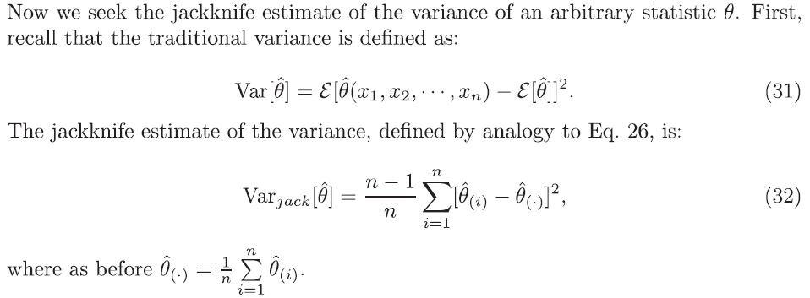

Slide 13





Slide 14

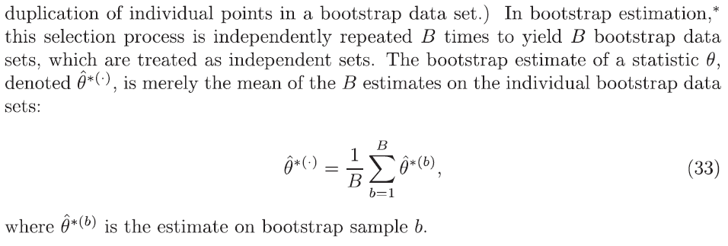

Slide 15




Slide 16


Slide 17
Thanks

